Slide 1

CSC 1100

Slide 2
Objectives
Describe the challenges of securing information
Define information security and explain why it is important
Identify the types of attackers that are common today
List the basic steps of an attack
Describe the five basic principles of defense

Slide 3
Computer Security is the ability of a system to protect information and system resources with respect to confidentiality and integrity.
Aspects of Security:
  Prevention: Take measures that prevent your assets from being damaged
  Detection: Take measures so that you can detect when, how, and by whom an asset has been damaged
  Reaction: Take measures so that you can recover your assets or to recover from a damage to your assets

Slide 4
Where to focus security controls?
Data: Format and content of data
Operations: Operations allowed on data
Users: Access control of data based on user

Slide 5
Security Attacks
Security Attack: Any action (active or passive) that compromises the security of information.
AIS-13

Slide 6
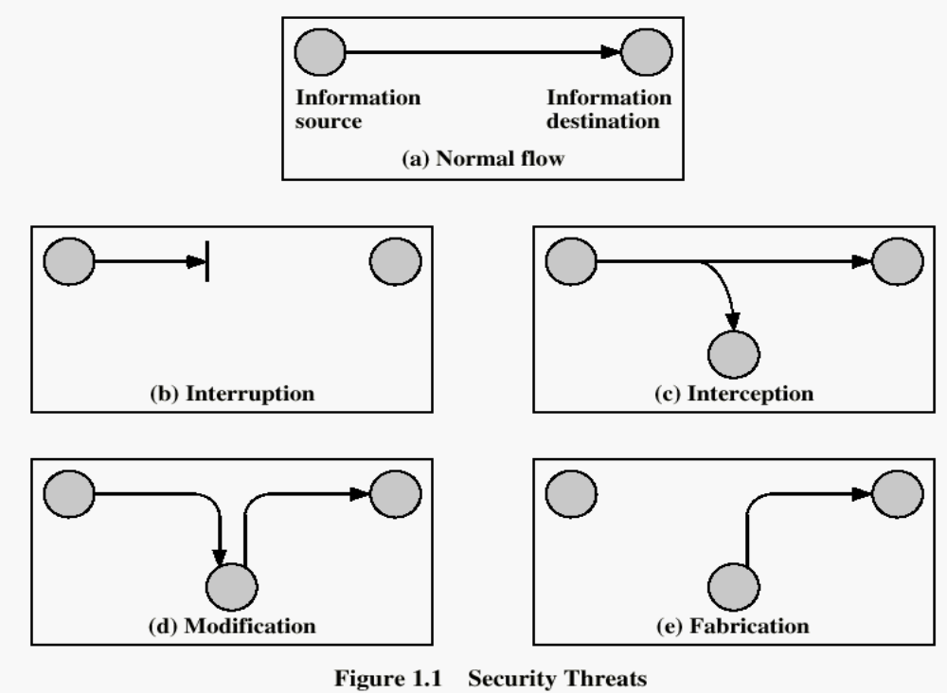
Security Threats/Attacks
AIS-13

Slide 7
Security Attacks
Interruption: This is an attack on availability
  Disrupting traffic
  Physically breaking communication line
Interception: This is an attack on confidentiality
  Overhearing, eavesdropping over a communication line

Slide 8
Security Attacks (continued)
Modification: This is an attack on integrity
  Corrupting transmitted data or tampering with it before it reaches its destination
Fabrication: This is an attack on authenticity
  Faking data as if it were created by a legitimate and authentic party

Slide 9
Difficulties in Defending Against Attacks
Universally connected devices
Increased speed of attacks
Greater sophistication of attacks
Availability and simplicity of attack tools
Faster detection of vulnerabilities
Delays in patching
  Weak distribution of patching

Slide 10
What Is Information Security?
Before defense is possible, one must understand:
  What information security is
  Why it is important
  Who the attackers are

Slide 11
Defining Information Security
Security
  Steps to protect person or property from harm
    Harm may be intentional or nonintentional
  Sacrifices convenience for safety
Information security
  Guarding digitally-formatted information:
    That provides value to people and organizations

Slide 12
Defining Information Security (cont’d.)
Three types of information protection: often called CIA
  Confidentiality
    Only approved individuals may access information
  Integrity
    Information is correct and unaltered
  Availability
    Information is accessible to authorized users

Slide 13
Defining Information Security (cont’d.)
Protections implemented to secure information
  Identification
    Proof of who you are
  Authentication
    Individual is who they claim to be
  Authorization
    Grant ability to access information
  Accounting
    Provides tracking of events

Slide 14
Information Security Terminology
Security - protection of information and property from theft, corruption, or natural disaster, while allowing the information and property to remain accessible and productive to its intended users
Threat - a possible danger that might exploit a vulnerability to breach security and thus cause possible harm
CSC100 Computer Literacy - Comp Sec

Slide 15
Information Security Terminology (cont’d.)
Risk - Event or action that causes loss of or damage to computer system
Ethics - Moral principles concerning computer use
Vulnerability
  Flaw or weakness
    Threat agent can bypass security
Attacks - A vulnerability that has been compromised and exploited to cause harm to a computer system
CSC100 Computer Literacy - Comp Sec

Slide 16
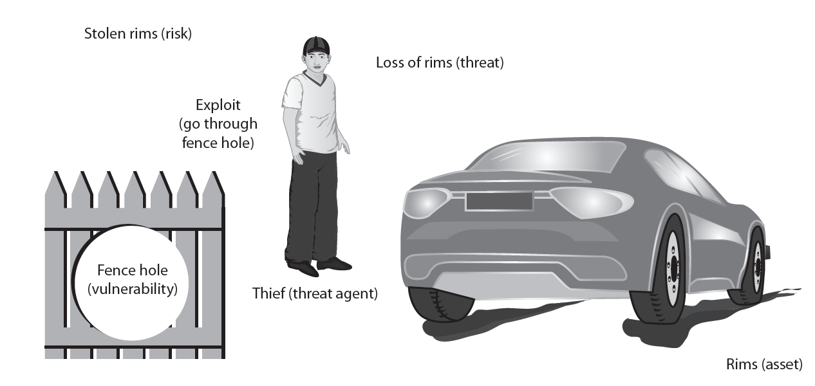
Figure 1-4 Information security components analogy

Slide 17
There are three primary reasons for network security threats:
    Technology weaknesses
      Computer and network technologies have intrinsic security weaknesses.
    Configuration weaknesses
      Network administrators or network engineers need to learn what the configuration weaknesses are and correctly configure their computing and network devices to compensate.
    Security policy weaknesses
      Security policy weaknesses can create unforeseen security threats. The network may pose security risks to the network if users do not follow the security policy.
    Human error

Slide 18
Goals of Network Security
Achieve the state where any action that is not expressly permitted is prohibited
      Eliminate theft
      Determine authentication
      Identify assumptions
      Control secrets

Slide 19
Creating a Secure Network Strategy
Firewalls
      Prevent unauthorized access to or from private network
      Create protective layer between network and outside world
      Log attempted intrusions and create reports
continued…

Slide 20
Creating a Secure Network Strategy
Access control
      Ensures that only legitimate traffic is allowed into or out of the network
    Passwords
    PINs
    Smartcards
continued…

Slide 21
Creating a Secure Network Strategy cont…
Change management
    Document changes to all areas of IT infrastructure
Encryption
    Ensures messages cannot be intercepted or read by anyone other than the intended person(s)
continued…

Slide 22
Creating a Secure Network Strategy
Intrusion detection system (IDS)
    Provides 24/7 network surveillance
    Analyzes packet data streams within the network
    Searches for unauthorized activity

Slide 23
Who Are the Attackers?
Categories of attackers
  Hackers
  Script kiddies
  Spies
  Insiders
  Cybercriminals
  Cyberterrorists

Slide 24
Hackers
Hacker
  Person who uses computer skills to attack computers
  Term not common in security community
White hat hackers
  Goal to expose security flaws
  Not to steal or corrupt data
Black hat hackers
  Goal is malicious and destructive

Slide 25
Script Kiddies
Script kiddies
  Goal: break into computers to create damage
  Unskilled users
  Download automated hacking software (scripts)
    Use them to perform malicious acts
  Attack software today has menu systems
    Attacks are even easier for unskilled users
  40 percent of attacks performed by script kiddies

Slide 26
Spies
Computer spy
  Person hired to break into a computer:
    To steal information
Hired to attack a specific computer or system:
  Containing sensitive information
Goal: steal information without drawing attention to their actions
Possess excellent computer skills:
  To attack and cover their tracks

Slide 27
Insiders
Employees, contractors, and business partners
48 percent of breaches attributed to insiders
Examples of insider attacks
  Health care worker publicized celebrities’ health records
    Disgruntled over upcoming job termination
  Government employee planted malicious coding script
  Stock trader concealed losses through fake transactions
  U.S. Army private accessed sensitive documents

Slide 28
Cybercriminals
Network of attackers, identity thieves, spammers, financial fraudsters
Difference from ordinary attackers
  More highly motivated
  Willing to take more risk
  Better funded
  More tenacious
  Goal: financial gain

Slide 29
Cybercriminals (cont’d.)
Cybercrime
  Targeted attacks against financial networks
  Unauthorized access to information
  Theft of personal information
Financial cybercrime
  Trafficking in stolen credit cards and financial information
  Using spam to commit fraud

Slide 30
Cyberterrorists
Cyberterrorists
  Ideological motivation
    Attacking because of their principles and beliefs
Goals of a cyberattack:
  Deface electronic information
    Spread misinformation and propaganda
  Deny service to legitimate computer users
  Commit unauthorized intrusions
    Results: critical infrastructure outages; corruption of vital data

Slide 31


Slide 32
Authentication Techniques
Usernames and passwords
Mutual authentication
Digital certificates
Biometrics
Multifactor authentication

Slide 33
Usernames and Passwords
Username
  Unique alphanumeric identifier used to identify an individual when logging onto a computer/network
Password
  Secret combination of keystrokes that, when combined with a username, authenticates a user to a computer/network

Slide 34
Basic Rules for Password Protection
Memorize passwords; do not write them down
Use different passwords for different functions
Use at least 6 characters
Use mixture of uppercase and lowercase letters, numbers, and other characters
Change periodically

Slide 35
Strong Password Creation Techniques
Easy to remember; difficult to recognize
Examples:
  First letters of each word of a simple phrase; add a number and punctuation
    Asb4M?
  Combine two dissimilar words and place a number between them
    SleigH9ShoE
  Substitute numbers for letters (not obviously)

Slide 36
Techniques to Use Multiple Passwords
Group Web sites or applications by appropriate level of security
  Use a different password for each group
  Cycle more complex passwords down the groups, from most sensitive to least

Slide 37
Storing Passwords
Written
  Keep in a place you are not likely to lose it
  Use small type
  Develop a personal code to apply to the list
Electronic
  Use a specifically designed application (encrypts data)

Slide 38
Digital Certificates
Electronic means of verifying identity of an individual/organization
Digital signature
  Piece of data that claims that a specific, named individual wrote or agreed to the contents of an electronic document to which the signature is attached

Slide 39
Electronic Encryption and
Decryption Concepts
Encryption
  Converts plain text message into secret message
Decryption
  Converts secret message into plain text message
Symmetric cipher
  Uses only one key
Asymmetric cipher
  Uses a key pair (private key and public key)

Slide 40
Biometrics
Biometric authentication
  Uses measurements of physical or behavioral characteristics of an individual
  Generally considered most accurate of all authentication methods
  Traditionally used in highly secure areas
  Expensive

Slide 41
How Biometric Authentication Works
Biometric is scanned after identity is verified
Biometric information is analyzed and put into an electronic template
Template is stored in a repository
To gain access, biometric is scanned again
Computer analyzes biometric data and compares it to data in template
If data from scan matches data in template, person is allowed access
Keep a record, following AAA model

Slide 42
False Positives and False Negatives
False positive
  Occurrence of an unauthorized person being authenticated by a biometric authentication process
False negative
  Occurrence of an authorized person not being authenticated by a biometric authentication process when they are who they claim to be

Slide 43
Different Kinds of Biometrics
Physical characteristics
  Fingerprints
  Hand geometry
  Retinal scanning
  Iris scanning
  Facial scanning
Behavioral characteristics
  Handwritten signatures
  Voice

Slide 44
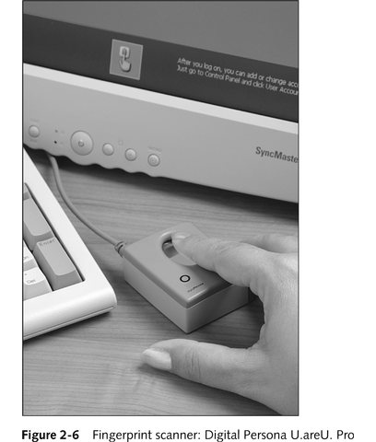
Fingerprint Biometrics

Slide 45
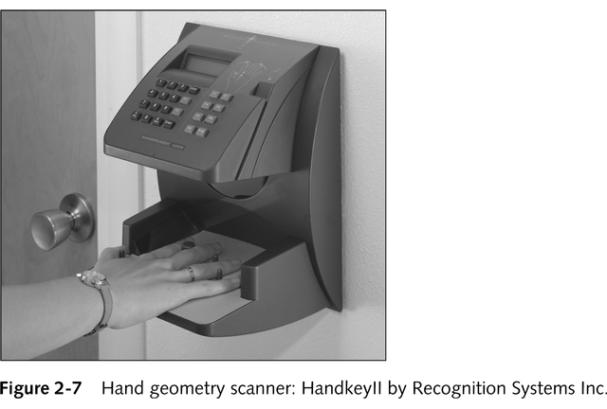
Hand Geometry Authentication

Slide 46
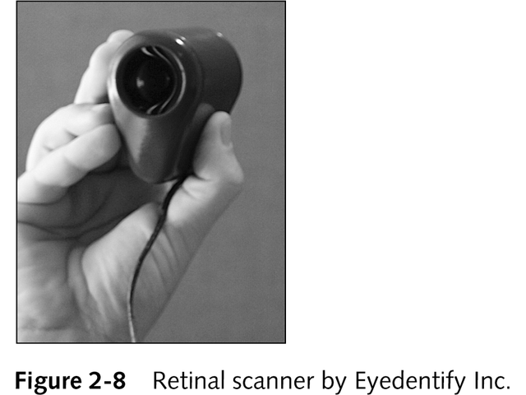
Retinal Scanning

Slide 47
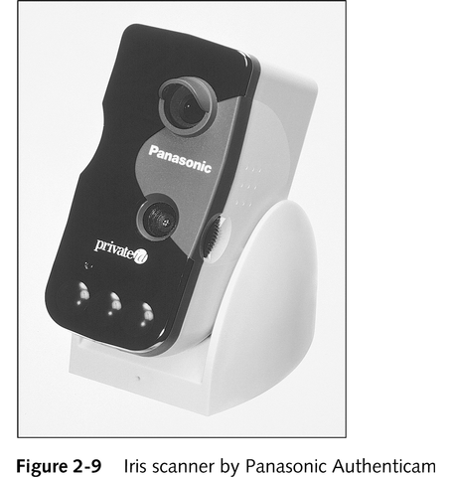
Iris Scanning

Slide 48
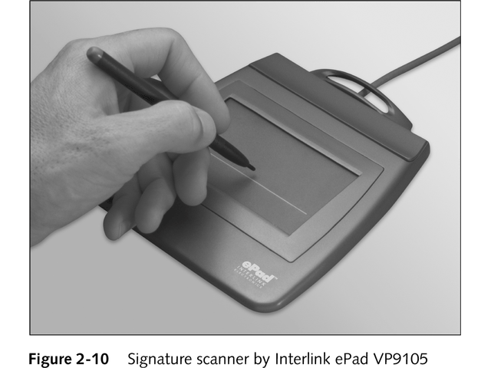
Signature Verification

Slide 49
Multifactor Authentication
Identity of individual is verified using at least two of the three factors of authentication
  Something you know (eg, password)
  Something you have (eg, smart card)
  Something about you (eg, biometrics)

Slide 50
Summary
Information security attacks are growing exponentially in recent years
Several reasons for difficulty defending against today’s attacks
Information security protects information’s integrity, confidentiality, and availability:
  On devices that store, manipulate, and transmit information
  Using products, people, and procedures

Slide 51
Summary (cont’d.)
Goals of information security
  Prevent data theft
  Thwart identity theft
  Avoid legal consequences of not securing information
  Maintain productivity
  Foil cyberterrorism
Different types of people with different motivations conduct computer attacks

